Slide 1
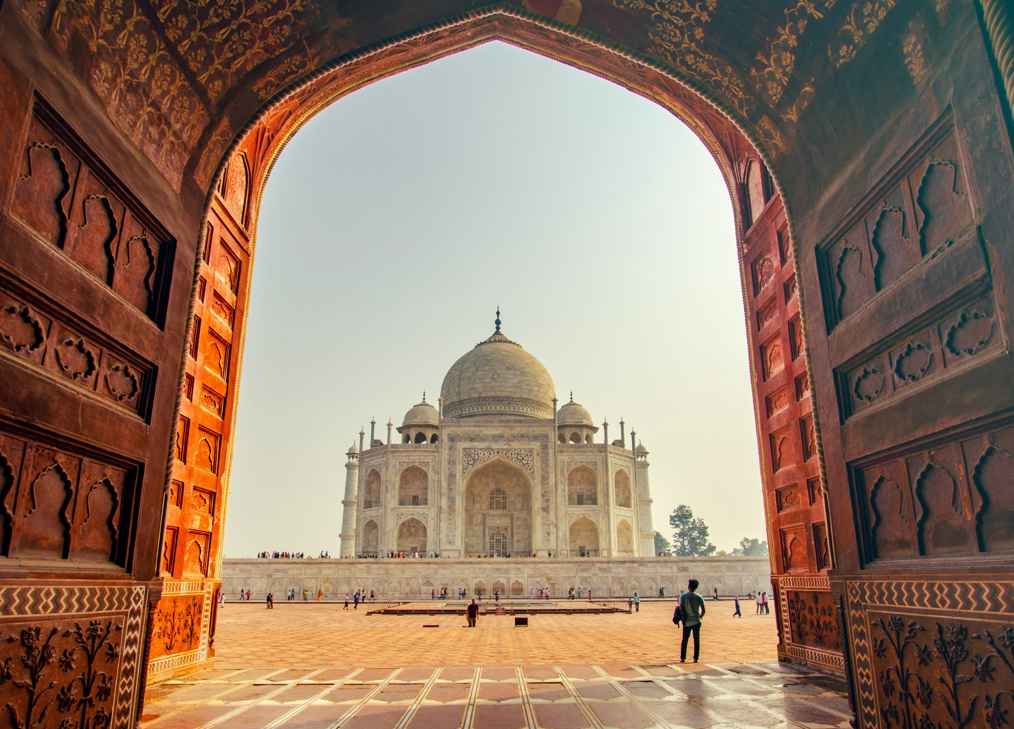
July 2024
India

Slide 2
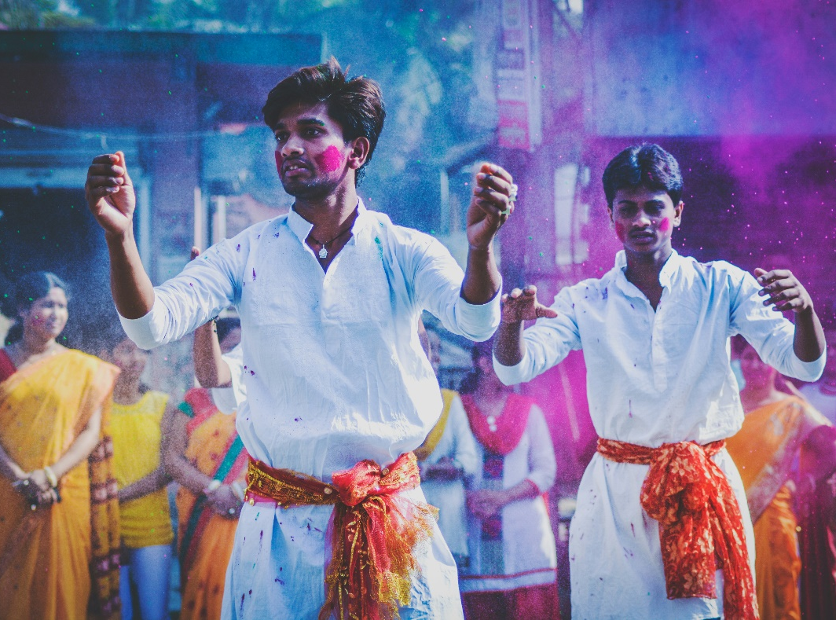
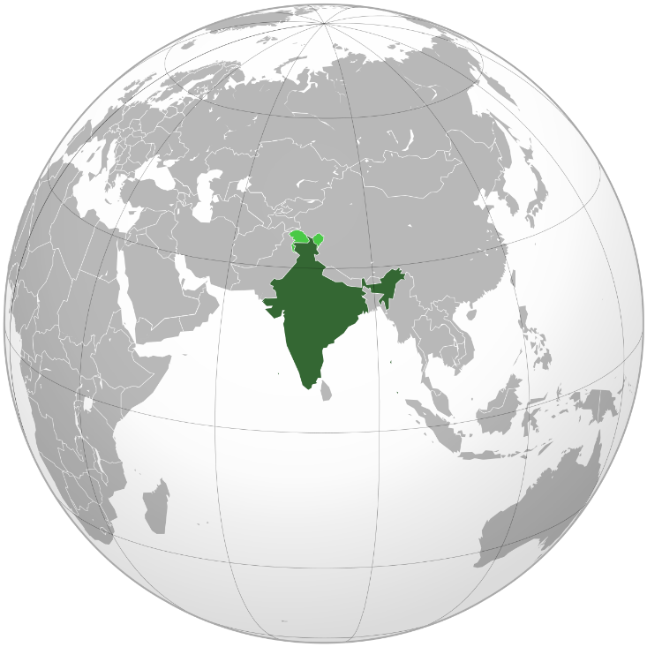
India
Population: 1.4 billion (1.3 billion unreached)
2,279 ethnic groups, with 2,048 unreached
Hindus: 72.4%
Muslims: 14%
Christians: 4.8%
Politics dominated by India’s right-wing
forces; tense relations among religions
Notes:
India has a population of 1.4 billion, of which 1.3 billion are unreached people.
Among the 2,279 ethnic groups in the country, 2,048 are unreached people groups.
India is known as the museum of world religions. Besides the 2 major religions of Hinduism and Islam, there are also Christianity, Sikhism, Buddhism, Jainism, Zoroastrianism, Judaism, and Bahá’i Faith.
The diverse religious environments led to many religious conflicts.
In 2023, India was classified as a “Country of Particular Concern” in terms of “Religious Persecution”, same as North Korea, Afghanistan, and Saudi Arabia.
The current Prime Minister Modi joined Rashtriya Swayamsevak Sangh (RSS), an extreme right-wing organization, at a young age.
RSS adheres to the Hindu nationalism, "Hindutva”, that dedicates to expanding Hindu nationalism, opposing secularized trends, and confronting Islamic culture.
The Hindu supremacy ideology caused tension among religions.

Slide 3
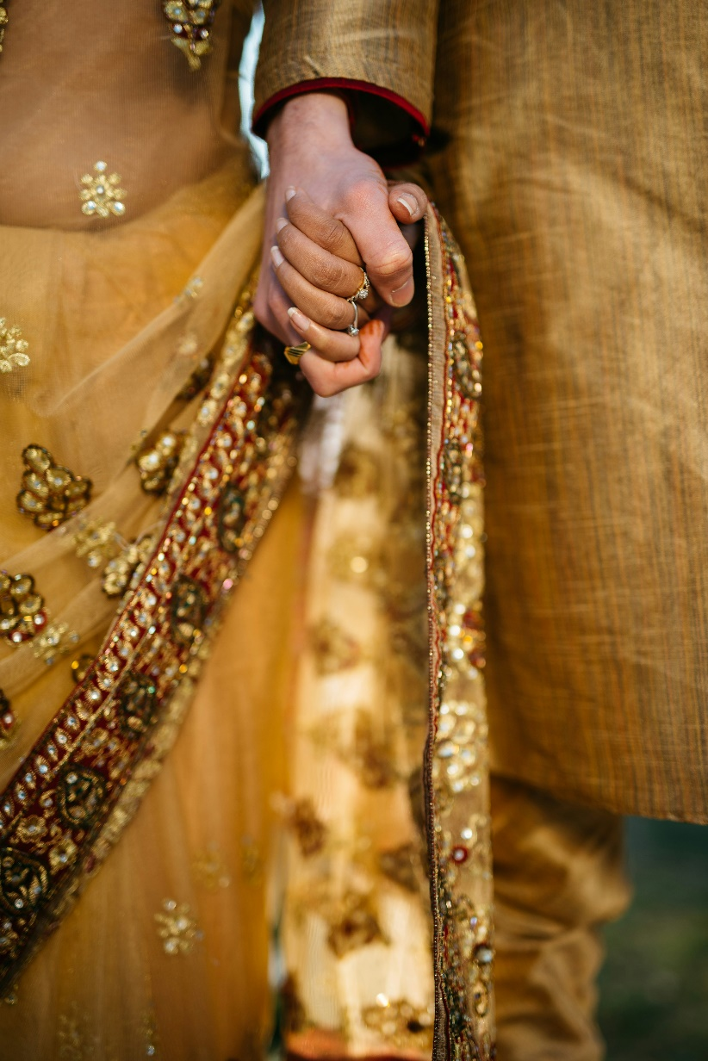
India Love Jihad
Hindus accused Muslims of systematically training Muslim men to be love scammers
Converting women to Islam through forces, deception, kidnapping, etc.
Fear of religious conversion is behind Love Jihad
Changing religion after marriage requires government approval
Notes:
In the past, the 4 major castes in India did not intermarry and strictly observed the boundary.
Although the caste system has been demolished, the idea of “no intermarriage” is still a major barrier for believers of different religions to be in romantic relationship.
The violent conflicts between the Hindus and Muslims in the land of South Asia have persisted for centuries.
Cross-religion relationships and intermarriage not only are family taboos but can even escalate to confrontations between villages or ethnic groups.
Love Jihad, also known as Romeo Jihad, is a conspiracy that emerged in India in 2009.
Hindus accused the Muslims of systematically training Muslim men to be love scammers, coercing, deceiving, and kidnapping Indian women to marry them and convert them to Islam.
In 2009, 2010, 2012, and 2014, the Indian government attempted multiple investigations, none of which had resulted in any evidence of Love Jihad.
However, that had not alleviated the fear of the non-Muslim communities, especially the Hindus.
The same concept incited the Hindus extremists “to kill the Muslims in the name of combating Love Jahid” and conversely promote Hindu Love Jihad, encouraging young women to marry Muslims to convert their belief.
Behind the “Love Jihad” is actually Hindus and Muslims’ fear of conversion. For them, religion is part of family, tradition, and ethnicity. Converting to another religion is considered a betrayal of family and society.
In 2020, Uttar Pradesh passed a law that anyone who uses forces or deception to convert another person to a different religion can be sentenced to up to 10 years of prison without bail.
The court will also declare “invalid” a marriage “for this purpose”. To change a person’s religion after marriage requires approval by the government.

Slide 4
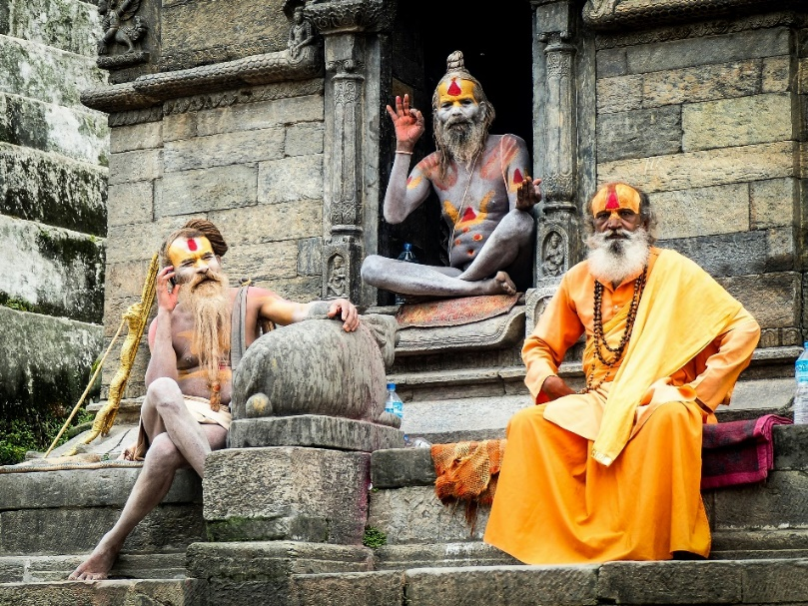
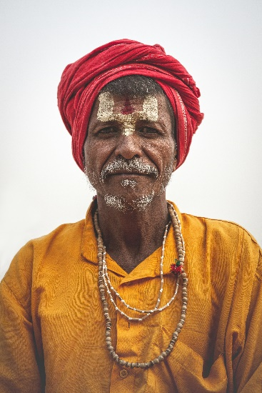
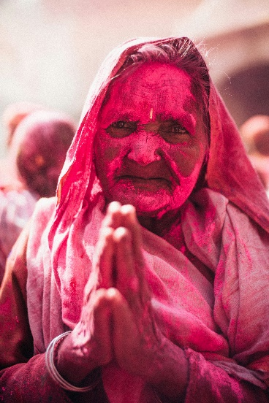
India Hindus
The Four Traditional Castes
Brahmins, Kshatriyas, Vaishyas, Shudras
The hereditary system of thought comes from the Hindu concept of reincarnation.
After India's independence, the "reservation system" replaced the caste system:
Scheduled Castes, Scheduled Tribes, Other Backward Classes, and Forward Classes
Notes:
Hinduism divided people into four castes based on birth, heredity, and occupation.
Four Major Castes
Brahmins: The highest class, considered intermediaries between gods and humans.
Kshatriyas: The ruling class.
Vaishyas: The class of wealth owners.
Shudras: Laborers, considered the lowest caste.
Origins and Injustice of the Caste System
The caste system originated around 1500 BC. After the Aryans invaded India, they integrated Brahminical teachings into Hinduism, advocating the caste system. The hereditary class (Varna) based on people’s birth background and occupation to divide them into four hierarchical classes, known as castes.
The hereditary mindset stems from the deeply ingrained Hindu belief in reincarnation.
Hindus believe in Dharma and Karma. if they fulfill their caste duties (Dharma) well, they earn good Karma points, bringing them closer to Nirvana.
Conversely, not adhering to their caste duties (for example, a Brahmin working as a waiter) results in losing Karma points, leading to a worse reincarnation in their next life.
Turning to other deities and religious systems is also considered a breach of Dharma.
After India's independence, the constitution prohibited caste discrimination. To assist the historically oppressed lower castes, the government classified the people into four categories:
Scheduled Castes
Scheduled Tribes
Other Backward Classes
Forward Classes
The first 3 categories are collectively referred to as Backward Classes. They are eligible for various degrees of resource subsidies in different areas, as well as reserved quota for higher education and government employment.

Slide 5
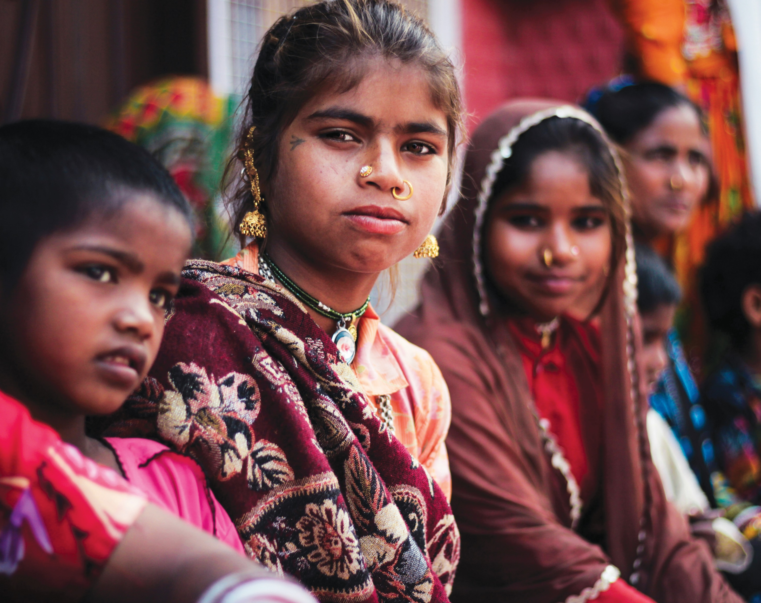
Let us pray for India together

Slide 6
Wonderful Counselor, Mighty God, Everlasting Father, Prince of Peace.
We lift our hands to call for Your peace to come upon India.
Politics cannot bring India peace.
The peace in the world is not the peace that You give.
May the Lord change the Indian politicians that
they will no longer use religious conflicts as means to gain votes.
Please calm the hatred that has been burning in the land of India for centuries.
Let the people of India see the love of Your cross is what we really need.
We ask the Lord to protect the women in India
Let them not be used as the excuse for men to attack each other.
Please help women in India to pursue love in a safer environment.
We also pray that You reveal Yourself to them as the God who loves them.
In the name of Lord Jesus Christ, we pray. Amen!
Notes:
Let us pray aloud for India in united hearts.

Slide 7
Lord, You created everyone in Your image.
Please liberate the Indian people from the caste mindset,
knowing that regardless of their background, they are God’s precious creation.
Yet, we have all fallen short of the glory of God,
therefore, we also need Your salvation.
Lord, please deliver the Hindus from the injustices of the caste system,
let them taste the freedom in the Holy Spirit.
Please help the Hindus to know You as the only true God.
In You, they found salvation and wisdom, love each other because of Your love.
The bonds of hatred has lasted too long.
Lord, please delay no more and quickly reveal Your truth to the Hindus.
In the name of Lord Jesus Christ, we pray. Amen!
Notes:
Let us pray aloud for India in united hearts.

Slide 8
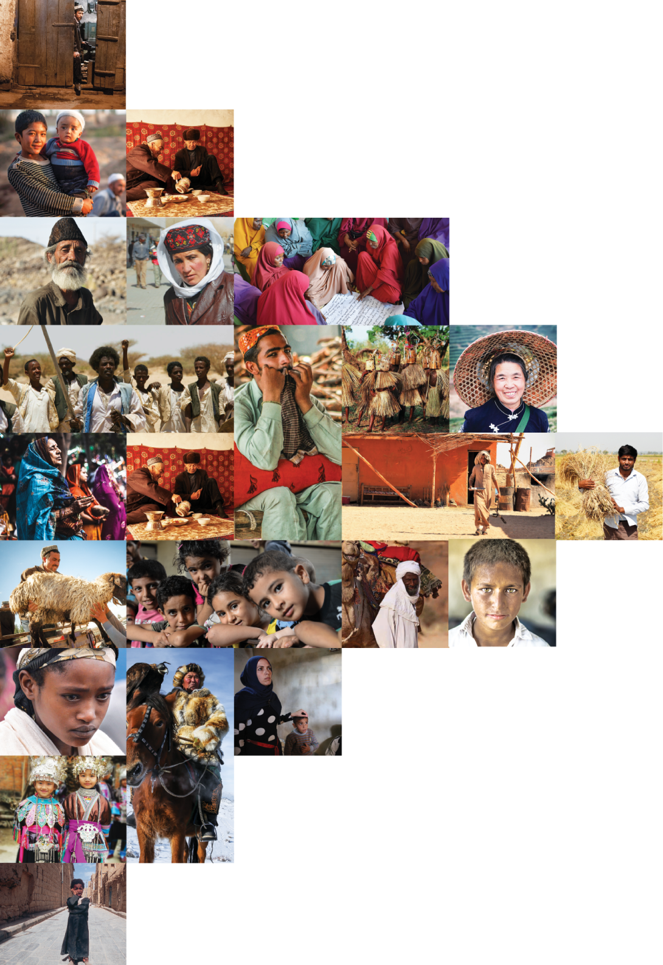
不再是個人的禱告，我們開始一起祈禱。 30分鐘，生活再忙碌的人都能找到時間參與。

